Slide 1

Course : COMP6176 / Human - Computer Interaction
Year : 2019
INTERFACES
SESSION 06

Slide 2
LEARNING OUTCOMES
• LO 4: Design the user requirements
with interaction styles

Slide 3
OUTLINE
^{Introduction}
^{Interfaces Types}
Natural User Interfaces and Beyond

Slide 4
INTRODUCTION
Until the mid-1990s , interaction designers developing efficient and effective user interfaces for desktop computers aimed at the single user.
Advances in graphical interfaces, speech, gesture, and handwriting recognition, together with the arrival of the internet, cell phones, wireless networks, sensor technologies and assortment of other new technologies providing large and small displays, have changed the face of human-computer interaction.

Slide 5
1. Command Line Interfaces
INTERFACE TYPES
The user type in command that were typically abbreviations (e.g.Is) at the prompt symbol appearing on the computer display
Another way is pressing certain combination of keys (e.g. Shift+Alt+Ctrl)
Some commands are fixed part of the keyboard
( e.g. delete, enter, and undo)
Other function can be programmed by user as specific commands ( e.g. F11 standing for print)

Slide 6
2. GUI (Graphical User Interface)
INTERFACE TYPES
The original GUI was called a WIMP (windows, icons, menus, pointer), consisted of the following :
Windows
could be scrolled, stretched, overlapped, opened, closed, and moved around the screen using the mouse
Icons
Represent applications , objects, commands, and tools that were opened, or activated when clicked on.
Menus
Offering lists of options that could be scrolled through and selected in the way a menu is used a restaurant.

Slide 7
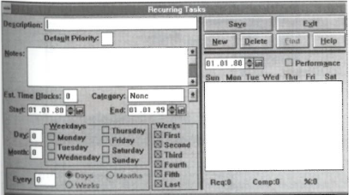
2. GUI
INTERFACE TYPES
The original GUI was called a WIMP (windows, icons, menus, pointer),consisted of the following :
Pointing device
A mouse controlling the cursor as a point of entry to the windows, menus, and icons on the screen.
The first generation of WIMP interfaces was boxy in design (see figure 06.01)
Figure 06.01 The First generation of WIMP

Slide 8
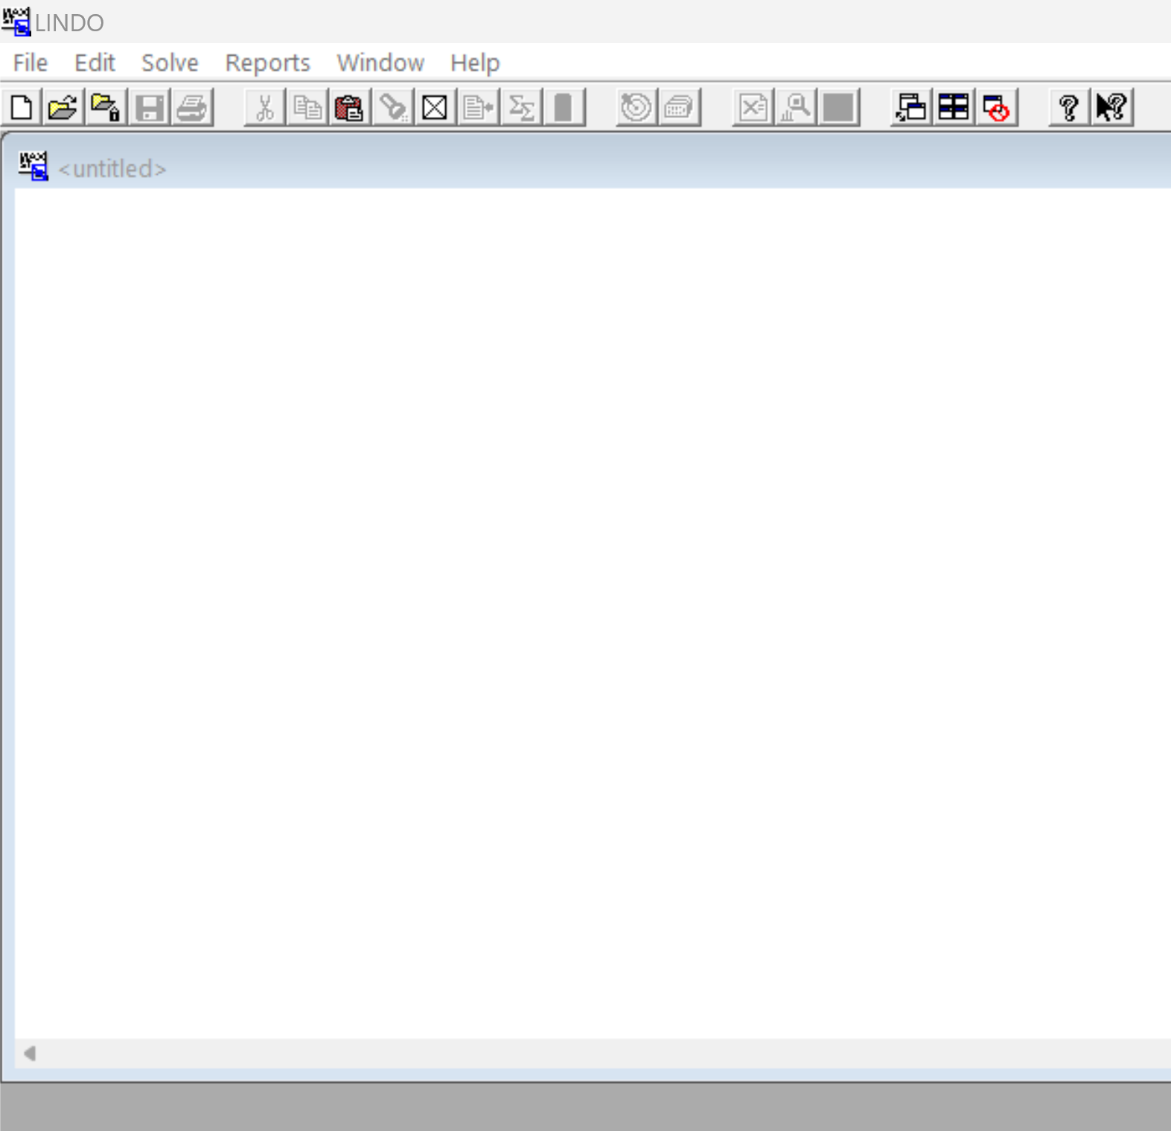

Slide 9
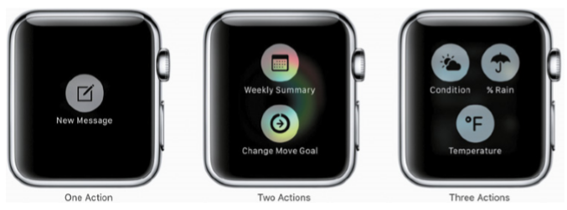
2. GUI
INTERFACE TYPES
Figure 06.02 Simple smartwatch menus with one, two, or three option

Slide 10
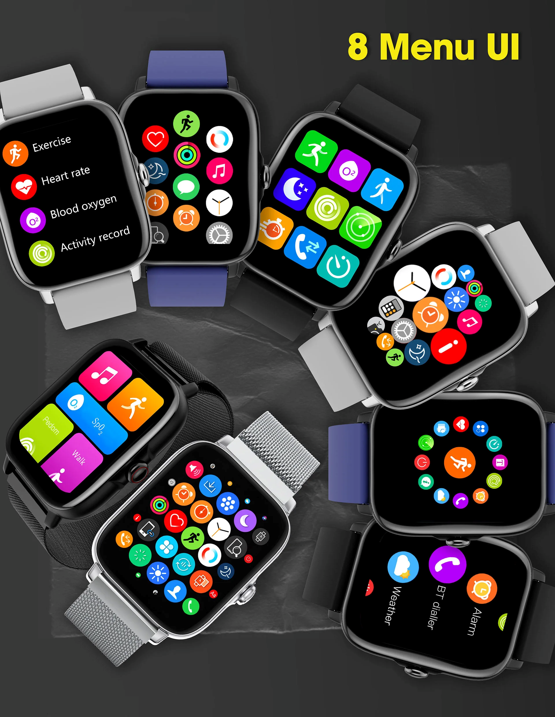

Slide 11
2. GUI
INTERFACE TYPES
Overview of the design issues concerning the basic
building blocks of the WIMP/GUI :
Window Design
invented to overcome the physical constraints of a computer display
Enabling more information to viewed and tasks to be performed at the same screen.
Multiple window can be opened at any one time.
The dialog box is kind of window that is commonly used in GUIS. Confirmations, error messages, checklist and forms are presented through them.

Slide 12
2. GUI
INTERFACE TYPES
Menu Design
Interface menus offer users a structure ways of choosing from the available set of options.
There are menu interface styles :
Flat list
Drop-down
Pop-up
Contextual
Expanding one e.g. scrolling and cascading.

Slide 13
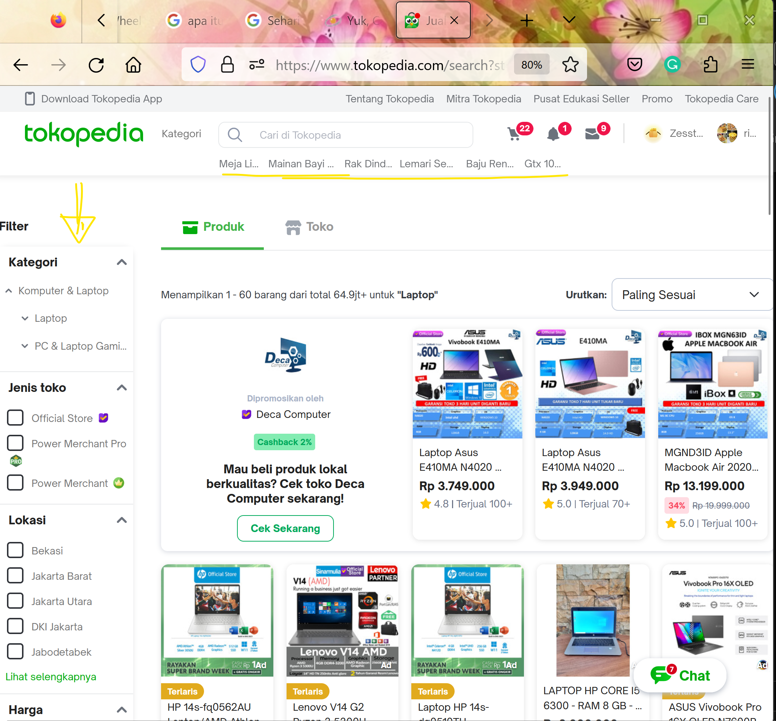

Slide 14
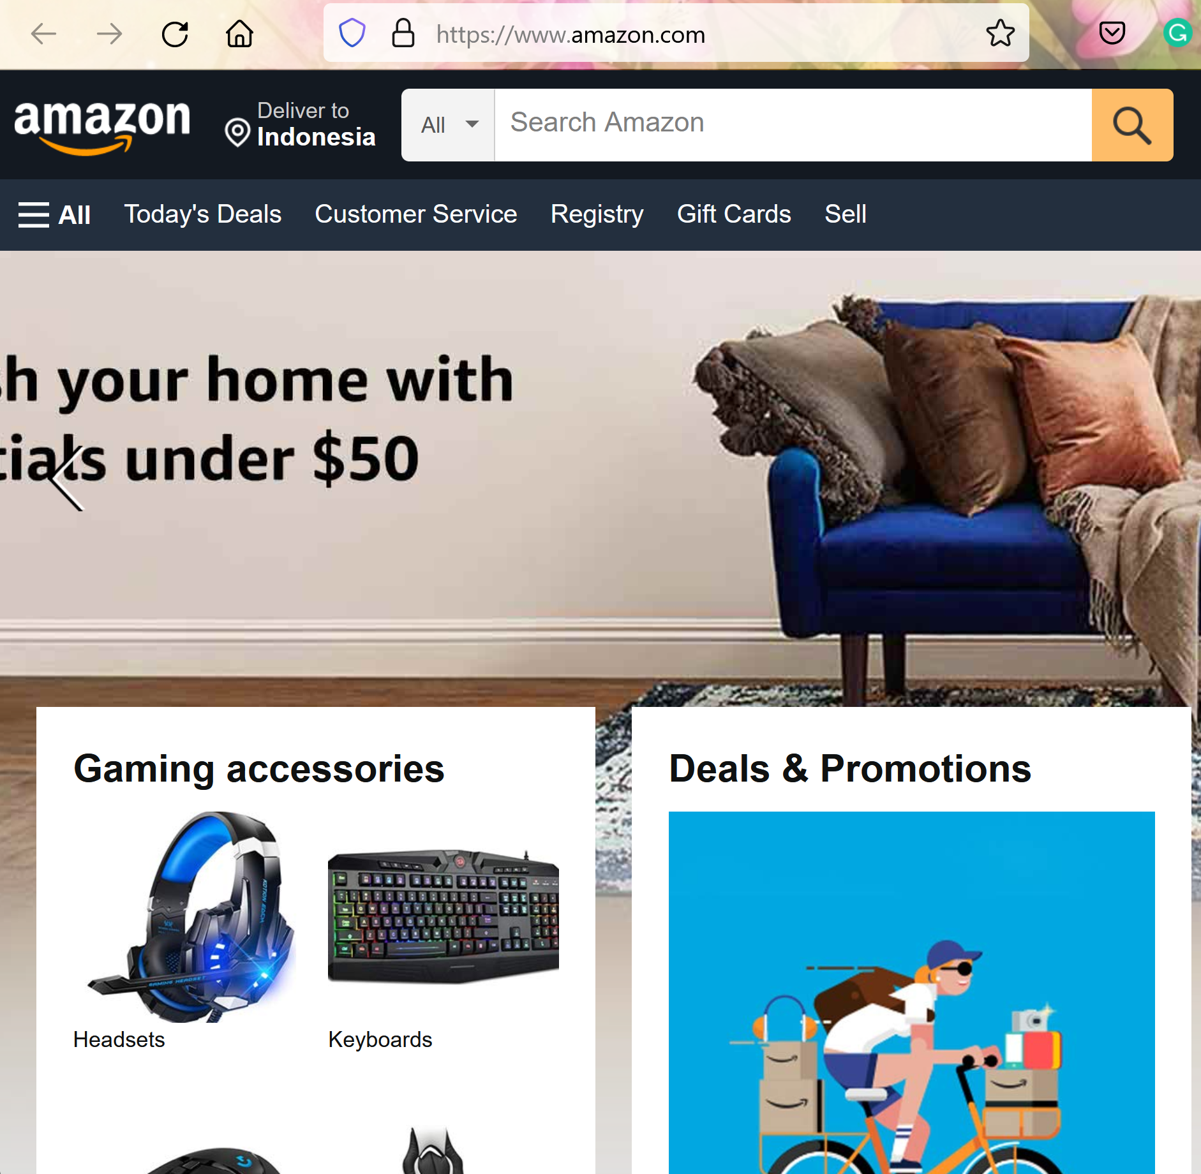
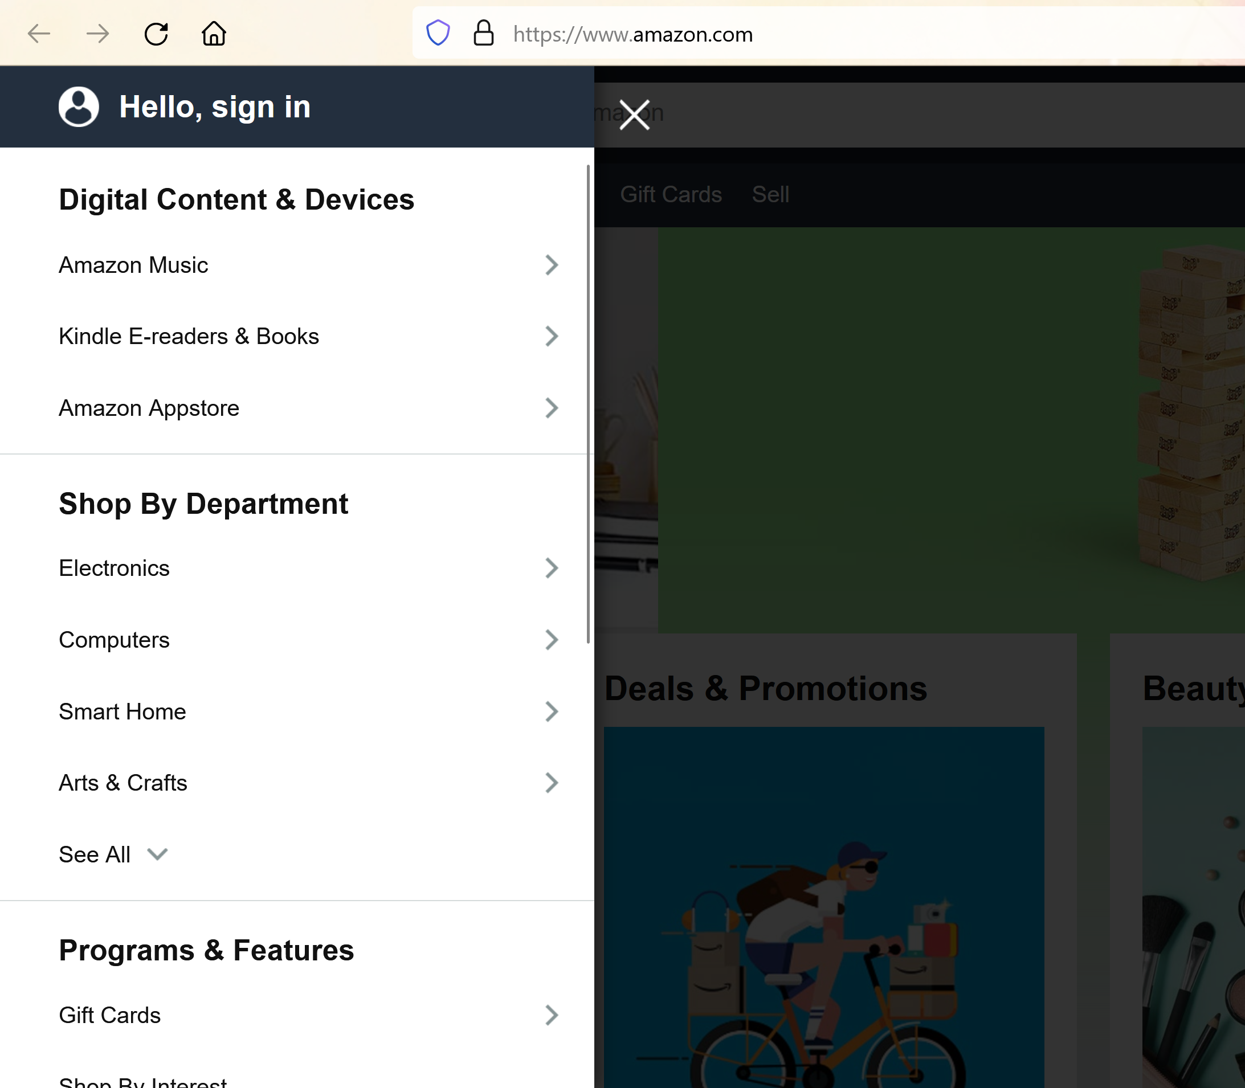

Slide 15
2. GUI
INTERFACE TYPES
Contextual menus provide access to often-used commands associated with a particular item e.g. an icon. They provide appropriate commands that make sense in the context of a current task.
The advantage of contextual menus is that they provide a limited number of options associated with an interface element, overcoming some of the navigation problems associated with an interface element, overcoming some of the navigation problem associated with cascading and expanding menus.

Slide 16
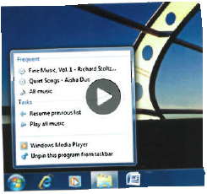
2. GUI
INTERFACE TYPES
Window 7 jump lists are a hybrid form of contextual window and contextual menu that provide short -cuts to files, sites, etc that are commonly visited. Depending on the program such as a web browser or media player, it will show frequently viewed sites or commonly played tunes (see figure 06.03)
Figure 06.03 Windows jump list

Slide 17
2. GUI
INTERFACE TYPES
Icon Design
The appearance of icons at the interface came about following the Xerox Star Project.
Used to represent objects as part of the desktop metaphor, namely folders, documents, trashcans, and in and out trays.
Using icons instead of text labels is easier to learn and remember especially for non expert computer users.
Icon can be designed to be compact and variably positioned on a screen.

Slide 18
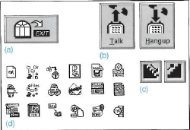
2. GUI
INTERFACE TYPES
Icon Design
From the late 1980s into the early 1990s the poorly designed icons at the interface ( see figure 06.04)
Figure 06.04 Poor icon set from the early 1990s

Slide 19
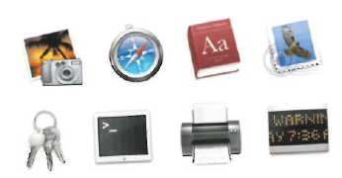
2. GUI
INTERFACE TYPES
Icon Design
Different graphical genre have been used to group and identify different categories of icons. See figure 06.05
Figure 06.05 Contrasting genres of Aqua icons used for the Mac. The top row of icons have been designed for user applications and the bottom row for utility applications.

Slide 20
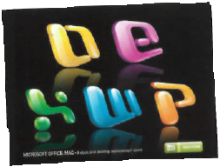
2. GUI
INTERFACE TYPES
Icon Design
Another approach has been to develop glossy, logo-style icons that are very distinctive, using only primary colors and symbols, having the effect of making them easily recognizable . (see Figure 06.06)
Figure 06.06 Logo-based Microsoft Office Mac Icons

Slide 21
3. Multimedia
INTERFACE TYPES
Multimedia as the name implies, combines different media within a single interface, namely graphics, text, video, sound and animations and links them with various forms of interactivity.
One of the distinctive features of multimedia is its ability to facilitate rapid access to multiple representations of information.
Multimedia has largely been developed for training, educational, and entertainment purposes

Slide 22
4. Virtual Reality
INTERFACE TYPES
Refers to the experience of interacting with an artificial environment, which makes it feel virtually real.
The term virtual environment (VE) is used more specifically to describe what has been generated using computer technologies.
One of the main attractions of VR is can provide opportunities for new kinds of experience, enabling users to interact with objects and navigate in 3D space in ways not possible in the physical world or a 2D graphical interface.

Slide 23
4. Virtual Reality
INTERFACE TYPES
One of advantages of VR is simulations of the world can be constructed to have a higher level of fidelity with the objects they represent compared with other forms of graphical interface e.g. multimedia. For example : landing and take-off terrains developed for flight simulators can appear to be very realistic.
Another Distinguishing feature of VR is the different viewpoints it can offer. Players can have a first-person perspective, where their view of the game or environment is through their own eyes, or a third-person perspective where they see through an avatar visually represented on the screen.

Slide 24
4. Virtual Reality
INTERFACE TYPES
First–person perspectives are typically used for flying/driving simulations and games, e.g. car racing where it is important to have direct and immediate control to steer the virtual vehicle.
Third-person perspectives are more commonly used in games, learning environments, and others in it.

Slide 25
5. Information Visualization
INTERFACE TYPES
Computer-generated graphics of complex data that are typically interactive and dynamic.
The goal is : to amplify human cognition, enabling users to see patterns, trends, and anomalies in the visualization and from this to gain insight (Card et al,1999).
Common techniques for depicting information and data are 3D interactive maps that can be zoomed in and out of and which present data via webs, trees, clusters, scatterplot diagrams, and interconnected nodes(Bederson, and Shneiderman,2003) (See Figure 06.07 & 06.08)

Slide 26
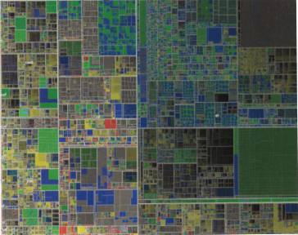
5. Information Visualization
INTERFACE TYPES
Figure 06.07 Million Vis , typical treemap.

Slide 27
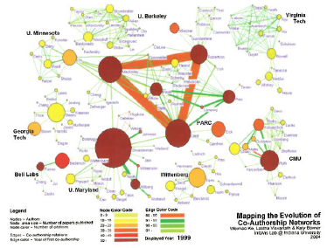
5. Information Visualization
INTERFACE TYPES
Figure 06.08 Type of Visualization using animated color networks that expand and change color over time

Slide 28
6. Web
INTERFACE TYPES
Early websites were largely text-based, providing hyperlinks to different places or pages of text.
Website design took off in a big way in the early 2000s when user-centered editing tools (e.g. Dreamweaver) and programming languages (e.g. PHP, Flash and XML) emerged providing opportunities for both designers and the general public to create websites to look and behave more like multimedia environments.
New languages, such as HTML5 and web development techniques , such as Ajax, started to appear, enabling applications to be built that are largely executed on a user’s computer, allowing the development of web applications that mimic desktop apps.

Slide 29
7. Consumer Electronics and Appliances
INTERFACE TYPES
Consumer electronics and appliances include machines for everyday use in the home, public space ( e.g. washing machine, DCD Players, etc) and personal devices ( e.g. MP3 player, digital clock)
What in common is that most people using them will be trying to get something specific done in a short period of time, such as putting the washing on, watching a program.

Slide 30
8. Mobile
INTERFACE TYPES
Mobile devices have become pervasive with people increasingly using them in all aspects of their everyday and working lives.
A number of physical controls have been developed for mobile interfaces, including a roller wheel positioned on the side of a phone and a rocker positioned on the front of a device – both designed for rapid scrolling of menus.
Soft keys( which usually appear at the bottom of a screen ) and silk-screened buttons ( icons that are printed on or under the glass of a touchscreen display ) have been designed for frequently selected options and for mode changing.

Slide 31
9. Speech
INTERFACE TYPES
A speech or voice user interface is where a person talks with a system that has a spoken language application, like a train timetable, a travel planner, or a phone service.
Speech-to-text systems become popular as PC and smartphone apps, such as Dragon Dictate.
Speech technology can be used by people with disabilities, including speech recognition word processors, page scanners, web readers, and speech recognition software for operating home control systems, including lights, TV, stereo, and other home appliances.
One of the most popular applications of speech technology is call routing, where companies use an automated speech system to enable users to reach one of their services.

Slide 32
10. Pen
INTERFACE TYPES
Pen based devices enable people to write, draw, select, and move objects at an interface using lightpens or styluses that capitalize on the well-honed drawing and writing skills that are developed from childhood.
They have been used to interact with tablets and large displays, instead of mouse or keyboard input, for selecting items and supporting freehand sketching.
The pen works by recognizing a special non-repeating dot pattern that is printed on the paper.
The digital pen can transfer data that has been stored in the pen via bluetooth or USB port to a PC.

Slide 33
11. Touch
INTERFACE TYPES
Touchscreens, such as walk-up kiosks ( e.g. ticket machines, museum guides), ATM, and till machines have been around for some time.
They work by detecting the presence and location of a person’s touch on the display, options are selected by tapping on the screen.
Multitouch surfaces have been developed as the interface for tabletops and cell phones that support a range of more dynamic finger tip actions, such as swiping, flicking, pinching, pushing, and tapping.

Slide 34
12. Air-based Gestures
INTERFACE TYPES
Camera capture, sensor, and computer vision techniques have advanced such that it is now possible to fairly accurately recognize people’s body, arm, and hand gestures in a room.
For example : Sony’s EyeToy, Wii Remote in Wii Gaming console, The Kinect used in Xbox.
Early systems used computer vision techniques to detect certain gesture types (e.g location of hand, movement of arm)that were then converted into system commands.
Other systems ten began using sensor technologies to detect touch, bend, and speed of movement of the hand and / or arm.
Ubi-Finger was developed to allow users to point at an object.(Tsukada and Yasumura,2002)

Slide 35
13. Haptic
INTERFACE TYPES
Haptic interfaces provide tactile feedback, by applying vibration and forces to the person, using actuators that are embedded in their clothing or a device they are carrying, such as a cell phone.
For example : The MusicJacket ( van der Linder, 2011) was developed to help novice violin players learn how to hold their instrument correctly and develop good bowing action

Slide 36
14. Multimodal
INTERFACE TYPES
Multimodal interfaces are intended to provide enriched and complex user experiences by multiplying the way information is experienced and controlled at the interface through using different modalities, i.e. touch, sight, sound, speech. (Bouchet and Nigay,2004)
An example : SpeechWork’s multimodal interface developed for one of Ford’s SUV concept cars which allows the occupants to operate on-board systems including entertainment, navigation, cell phone, and climate control by speech.

Slide 37
15. Shareable
INTERFACE TYPES
Shareable interfaces are designed for more than one person to use. For example : SmartBoards where people use their own pens or gestures, and interactive tabletops, where small groups can interact with information being displayed on the surface using their fingertips.
Ad advantage of shareable interfaces is : provide a large interactional space that can support flexible group working, enabling groups to create content together at the same time.
Shareable interfaces also been designed to literally become part of the furniture. For example , Philips designed the Café Table that displays a selection of contextually relevant content for the local community.

Slide 38
16. Tangible
INTERFACE TYPES
Tangible Interfaces use sensor-based interaction, where physical objects, e.g. bricks, balls, and cubes, are coupled with digital representations.
When a person manipulates the physical object(s), it is detected by a computer system via the sensing mechanism embedded in physical object, causing a digital effect to occur, such as a sound, animation, or vibration.
The technologies that have been used to create tangibles include RFID tags embedded in physical objects and digital tabletops that sense the movements of objects and subsequently provide visualization surrounding the physical objects.
One advantage is that physical objects and digital representations can be positioned, combined, and explored in creative ways, enabling dynamic information to be presented in different ways.

Slide 39
17. Augmented and Mixed Reality
INTERFACE TYPES
Augmented reality was mostly experimented with in medicine, where virtual objects e.g. X-Rays and scans were overlaid on part of a patient’s body to aid the physician’s understanding of what is being examined or operated on.
Another approach is to augment everyday graphical representations, e.g. maps with additional dynamic information.
An illustrative application is the augmentation of paper-based maps with photograph and video footage to enable emergency workers to assess the effects of flooding and traffic. (Reitmayr et al, 2005)
Augmented reality has also been developed for smartphone apps to aid people walking in a city or town.

Slide 40
18. Wearables
INTERFACE TYPES
Since the early experimental days of wearable computing where Steve Mann(1997) donned head and eye cameras to enable him to record what he saw while also accessing digital information on the move.
New flexible display technologies, e-textiles, and physical programming ( e.g. Arduino) provide opportunities for thinking about how to embed such technologies on people in the clothes they wear.

Slide 41
19. Robots
INTERFACE TYPES
Robots most notably as characters in science fiction movies, but also playing an important role as part of manufacturing assembly lines, as remote investigators of hazardous locations and as search and rescue helpers in disasters or far away-place.
Domestic robots that help with the cleaning and gardening have become popular. Robots are also developed to help the elderly and disabled with certain activities, such as picking up objects and cooking meals.

Slide 42
20. Brain-Computer
INTERFACE TYPES
Brain-Computer Interfaces (BCI) provide a communication pathway between a person’s brain waves and an external device such as a cursor on a screen or a tangible puck that moves via airflow).
The way BCIs works is through detecting changes in the neural functioning on the brain.
Brain-computer interfaces have also been developed to control various games. For example : Brainball

Slide 43
NATURAL USER INTERFACES
AND BEYOND
A Natural User Interfaces (NUI) is one that enables us to interact with a computer in the same ways we interact with the physical world, through using our voices, hands, and bodies.
Instead of using a keyboard and a mouse , a NUI allow us to speak to machines, stroke their surfaces, gesture at them in the air, dance on mats that detect our feet movements, smile at them to get a reaction, and so on.

Slide 44

REFERENCES
Interaction Design 5th Edition 2019, Chapter 7
http://desarrolloweb.dlsi.ua.es/cursos/2015/hci/user-interface-design
http://www.cse.chalmers.se/research/group/idc/ituniv/kurser/07/mdi/pdf%20files/Chapter_6.pdf

